Slide 1

Demand Response Network Code
SolarPower Europe Assessment on ACER published text on March 2025
4 July 2025

Slide 2
SolarPower Europe Priorities During ACER Proposal (November 2024)
Priority 1: Expand the use of DMDs & enable its use for all mass-produced DERs (Article 19, 20 and 21)
Priority 3: Harmonised standards for interoperability (NEW proposed Article 32)
Priority 4: Market based procurement & derogation rules (Article 38 to 41 and 49 to 51)
Priority 5: FCAs framework and use of power control systems for FCA application (Article 40)
Priority 6: Harmonised prequalification for FCR as Balancing Services (Article 29)
Priority 2: Simplify and harmonise data requirements for aggregated assets and mass-produced DERs across EU (Article 61)
Priority 7: Stakeholders involvement and Implementation of requirements (Article 15)

Slide 3
SolarPower Europe Priorities updated, after ACER Proposal (July 2025)
A Flexible Connection Agreement can only be dynamically activated when a designated device is defined, appropriate compensation incentives are in place, and the necessary communication requirements are met.
The EU must harmonise technical requirements for solar and storage. Without this, the current Network Codes risk leading to 27 fragmented national approaches, hindering market integration and slowing innovation. EU-wide standards are urgently needed for:
2. Data communication – including communication with grid operators, flexibility service providers, and energy management systems at the asset level.→ To be addressed through the Network Code on Demand Response (NC DR)
3. Prequalification of Distributed Energy Resources – for participation in grid services such as balancing, local flexibility markets, and grid stability services (such as grid-forming capabilities and inertia).→ To be defined in the NC DR and the upcoming Electricity Balancing Guideline (2026)

Slide 4
Priority 1: FCAs & Market-based Procurement (Whereas 22, Articles 2, 29 – 32)
  Flexible grid connection agreements and power control systems (Whereas 22, Articles 2, 31)
(+) System operators shall not limit the possibility for system users with flexible connection agreements to: (a) provide balancing and local services in the relevant markets, except for limitations due to grid prequalification following Article 49 and temporary limits following Article 50; and (b) participate in other electricity markets, to the extent that such participation is not impeded by activation of the flexible connection agreement.
(-) Explicit wording stating that FCA is not free of cost has not been integrated.
(-) The power control system definition and use for the activation of FCA has not been integrated.
(?) System operators must treat flexible connection agreements as firm connection agreements when assessing the need for local services under Article 29(1). This does not apply to flexible connection agreements designed as permanent solutions, as per Article 6a(1)(c) of Directive (EU) 2019/944.
(?) When a flexible connection agreement is activated after the day-ahead market gate closure, the transmission system operator must calculate an imbalance adjustment based on the restriction it causes to the balancing responsible parties' trade schedules. No adjustment is made if a party changes its schedules in a way that increases the restriction after activation.
Market-based procurement of local services (Articles 29, 30, 32 )
(+) Every two years, SOs (unless exempt) must assess the need for and procurement of demand response, energy storage, or other alternatives to system expansion. They must publicly consult on this assessment and use it to meet obligations under Articles 32(3) and 51(3) of Directive (EU) 2019/944, taking into account the national report on flexibility needs from Regulation (EU) 2019/943.
(+) SOs shall procure local services within a bidding zone under a market-based mechanism unless the regulatory authority has granted a derogation according to Article 30
(+) Most of the proposed amendments from November 15 were accepted, including the wording on economic incentives to promote demand response.
(+) The derogation issued by the regulatory authority shall specify its duration, which shall not be longer than two years - (?) unless it is a derogation for the procurement of voltage control services with reactive power, which can be longer;
(?) There is a separate set of rules and opportunities for reactive power, as it is not as developed.

Slide 5
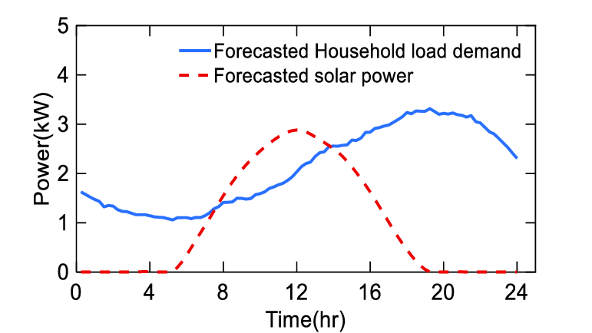
SolarPower Europe distinguishes two types of FCAs
Reduction of injection based on post-market signal (10h – 12h)
Reduction of withdrawal based on post-market signal (19h – 22h)
Regular grid connection agreement
Example with a 5kWp agreement - The generator or the consumer can inject or withdraw as much electricity as needed between 0 and 5 kWp.
Standard flexible grid connection agreement (static)
Definition: a contract including a static, unchanged overtime maximum limit to injection and/or withdrawal of electricity
Example with a 2.5 kWp FCA:
In the example, the contract is capped at 2.5 kWp – no injection above or withdrawal above 2.5 kWp.
The consumer can optimize their power generation by adding a battery or an energy management system monitoring their electric appliances
Flexible grid connection agreement with a dynamic emergency clause
Definition: a contract including a clause whereby the maximum injection or withdrawal capacity is limited upon request of the grid operator in emergency situations.
Example with a 2.5 kWp FCA:
In the example, aside from the capped as a static FCA. A reduction of the injection and withdrawal can be activated based on post-market needs
The consumer can optimize their power generation by adding a battery or an energy management system monitoring their electric appliances

Slide 6
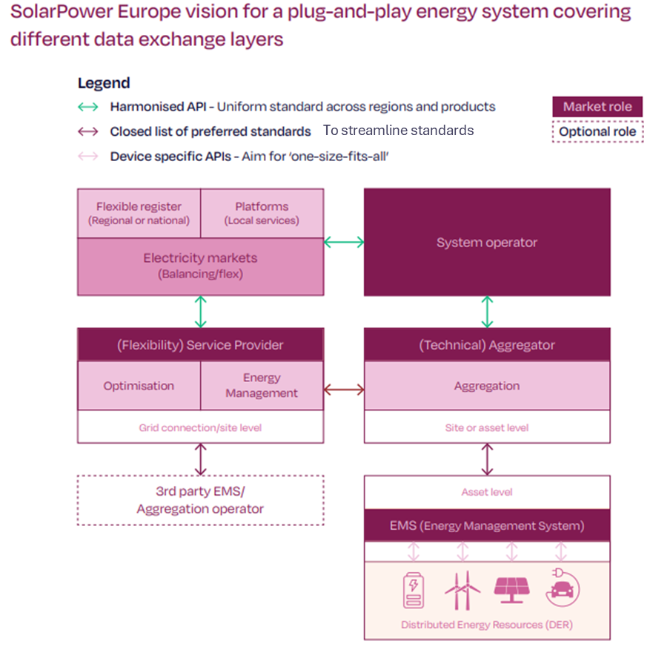
Priority 2: Interoperability for Demand Response
(+) Data harmonisation is now clearly required for standard flexibility products, including FCR.
(+) The Electricity Balancing Guidelines (EBGL) amendment now calls for harmonised data interfaces for balancing markets, using ETSI-CEN-CENELEC standards as asked by SolarPower Europe.
(-) System operators should refrain from burdensome data requests for distributed assets, only if the data is truly necessary. System operators should either use aggregated data from service providers or ask for standardisation if they need more detailed data.
(-) PCS and data interfaces related to power control systems (PCS), when activating FCAs, are still missing from the text
(-) The current text still refers to national standards for data exchanges in national products. Member States using local standards should justify them against equivalent ETSI-CEN-CENELEC standards.
Note: Regarding the work to be done on the Implementing Regulation, there may be gaps, particularly the lack of provisions for downstream data exchange, such as interfaces between technical aggregators and end devices, as originally proposed.

Slide 7
Priority 3: Harmonised prequalification for all demand response products
Union-Wide Methodologies Impact: (Article 21) Within 12 months after the entry into force of this Regulation, ENTSO-E and EU DSO entities shall develop a proposal for a Union-wide methodology for further simplification of the product prequalification processes. The proposal shall identify cases where product prequalification can be replaced by product verification and shall describe simplifications in the processes, requirements and activation tests where applicable, including specific simplifications where at least a potential SPU or SPG exclusively consists of small controllable units or controllable units that are identical to controllable units being part of other SPUs or SPGs previously prequalified by any SP.
Harmonisation alignments: (Article 32 and 38) Mention that there *will* be harmonisation of local product attributes, starting in three years. But the Code does not foresee harmonisation of local product requirements (Art. 39). And the table of Equivalences is meant to be national, not European-wide (Art. 16).
Assessment:
(+) It is great to see that a coordinated, simplification work is foreseen for all product validation.
(+/-) But will this work in practice if the DR NC doesn’t require System Operators to harmonise product requirements, such as those needed for V2G EV/EVSE interoperability required under the RfG NC, for example?
(-) The execution timeline has been extended, and harmonisation work is largely deferred to future methodologies, which will only begin once code implementation is underway, raising concerns about when Member States will align. → Harmonisation of product validation, attributes, and requirements should start now.

